Slide 1
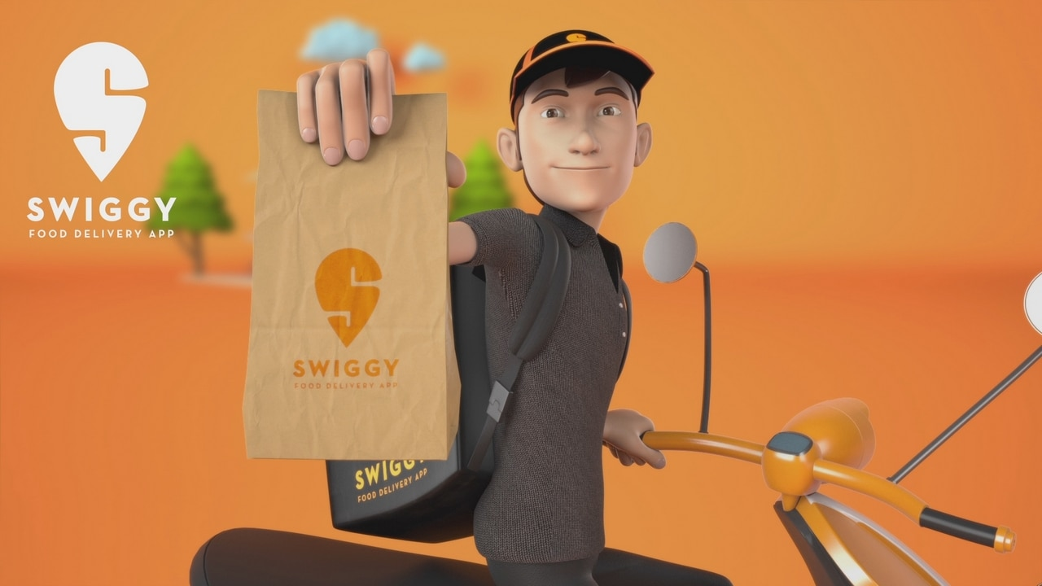
Swiggy Business Model & Problem-Solving Deep Dive

Slide 2
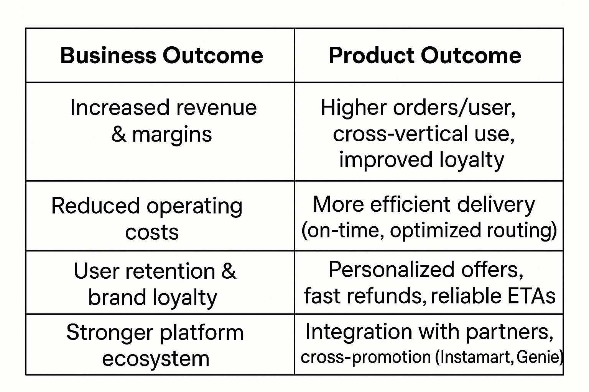

Business Model Understanding
Swiggy operates as a hyperlocal, on-demand delivery platform, primarily focusing on connecting users with restaurants, grocery stores, and service providers. The companyʼs evolution has transformed it into a full-stack convenience platform—not just a food delivery app.
Core Revenue Streams
Restaurant commissions (15-25% per order)
Delivery charges from customers
Advertising & promoted listings on the platform Subscription plans (Swiggy One)
Grocery delivery (Instamart)
Parcel & pickup/drop (Genie)
Professional services (via the Pyng app in 2025)
B2B partnerships with FMCG and restaurant brands

Slide 3
2. User Research & Problem Definition
Target User Segment
Urban professionals, students, families in metro and Tier-1/2 cities
Tech-savvy, convenience-driven individuals
Those seeking rapid food, grocery, or specialized services
User Validation
User interviews & feedback loops: Regular calls,
incident reviews, in-app ratings
Analyzing support tickets, churn triggers: Missing
items, late deliveries, slow refunds
A/B testing: UX flows, ETA algorithms, promotional
strategies
Unmet Needs
Reliability: Faster, more accurate delivery times; fewer order mix-ups
Transparency: Real-time order tracking and proactive notifications
Personalization: Context-aware offers, relevant recommendations
Clarity: Simpler, less cluttered app UI for expanding services
Seamless Support: Fast refunds and helpful customer care
Problem Breakdown
Delivery delays, inaccurate ETAs, missed or wrong items
App navigation complexity from feature bloat
Erosion of trust after repeated service failures
Users attracted solely by offers—not loyalty

Slide 4
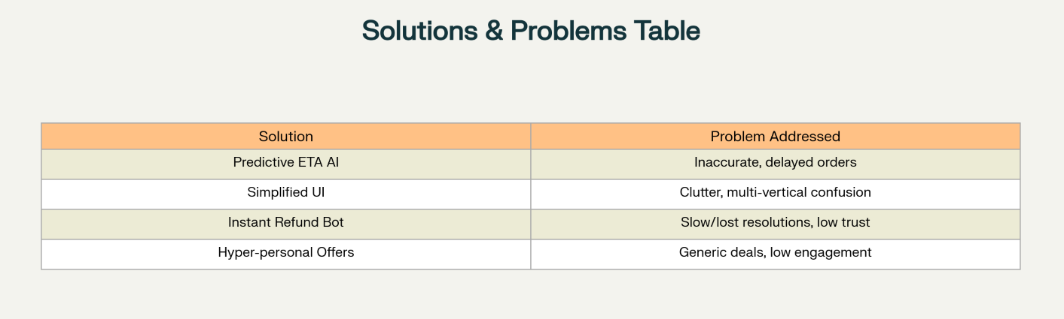
3. Solution Ideation & Decision-Making
3. Solution Ideation & Decision-Making3. Solution Ideation & Decision-Making3. Solution Ideation & Decision-Making3. Solution Ideation & Decision-Making3. Solution Ideation & Decision-Making3. Solution Ideation & Decision-Making3. Solution Ideation & Decision-Making3. Solution Ideation & Decision-Making3. Solution Ideation & Decision-Making3. Solution Ideation & Decision-Making3. Solution Ideation & Decision-Making3. Solution Ideation & Decision-Making3. Solution Ideation & Decision-Making3. Solution Ideation & Decision-Making3. Solution Ideation & Decision-Making
Ideation Process
Data-driven analysis of order logs, complaints, engagement patterns
Design thinking and cross-functional brainstorming
Prototyping and rapid experiments on the app
Predictive ETA AI: Increases reliability, reduces complaints, builds retention.
Instant Refund Bot: Instantly resolves service failures, boosting trust and re-order frequency.

Slide 5
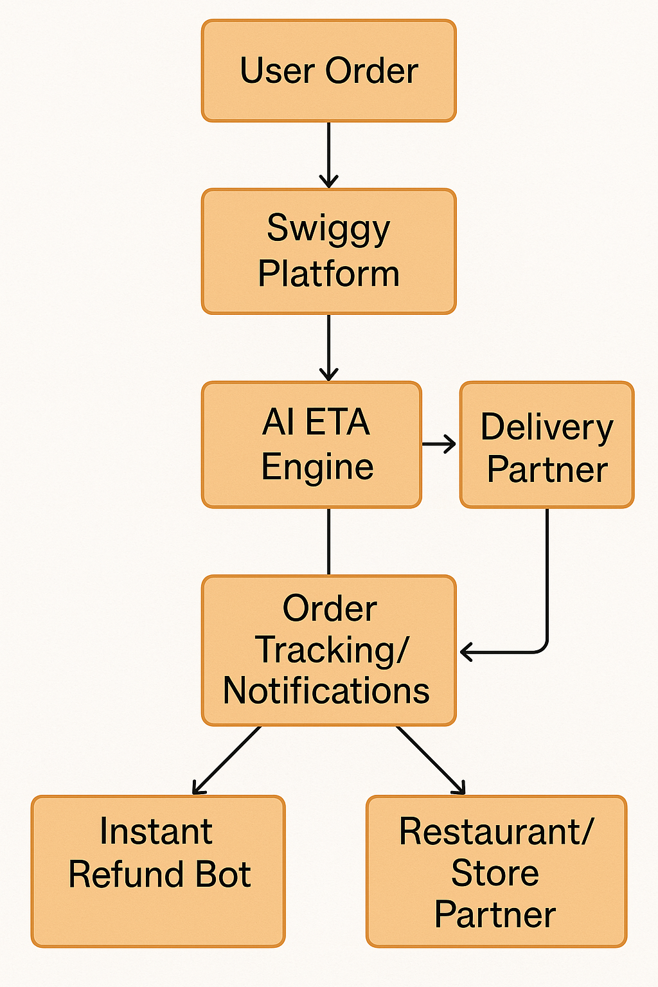
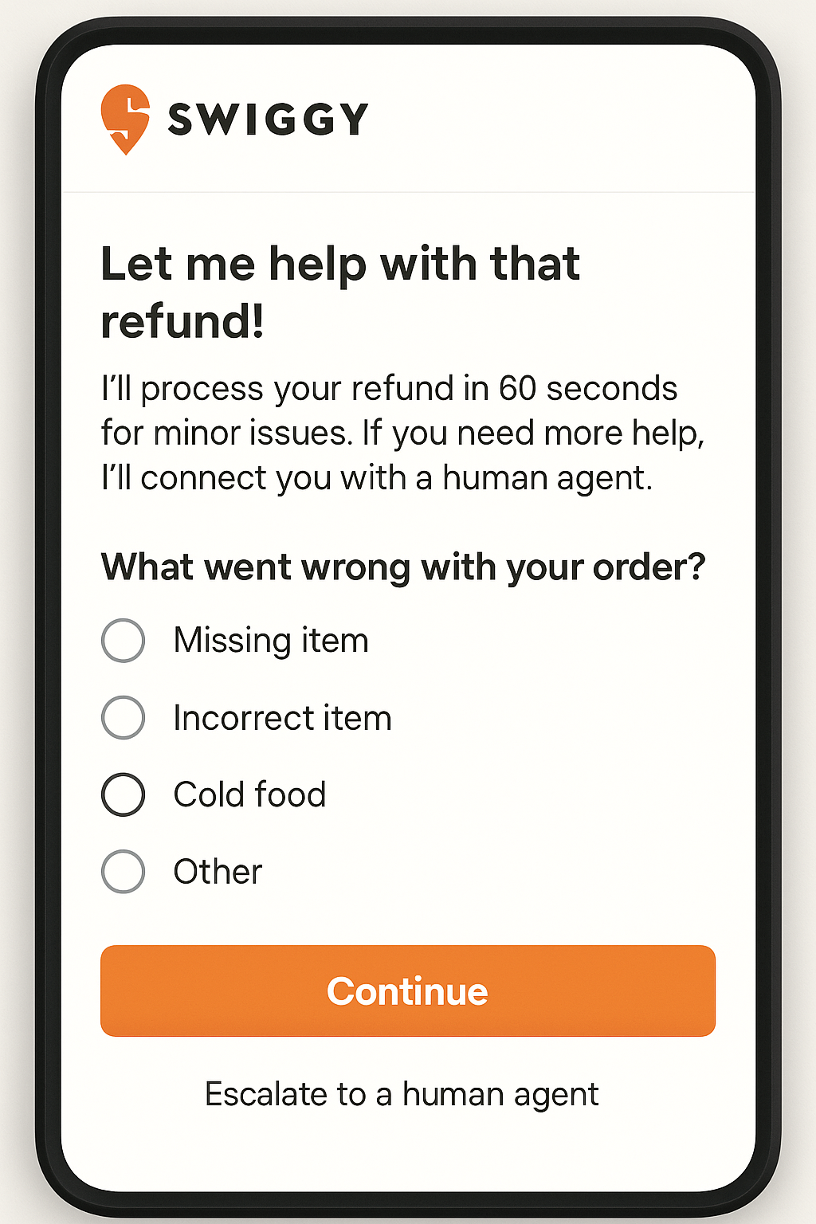

Slide 6
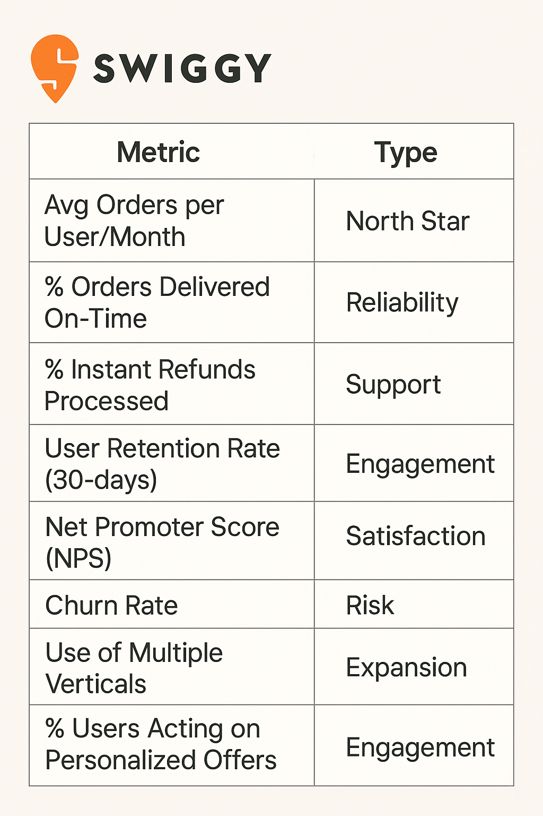
4. Second-Order Thinking & Success Metrics

Slide 7
5. Risk Assessment
Key Failure Points
Algorithmic Blind Spots: Unpredicted traffic or weather factors mislead ETA promises,frustrating users.
UI Overload: Further expansion dilutes focus, confusing new and existing users.
Support Automation Errors: False negatives in incident detection lead to unresolved user pain.
Market Competition: Aggressive discounts from competitors lure price-sensitive users away, undercutting loyalty.
Mitigations
Regular human review and data-driven feedback loops.
Segmented app navigation updated based on real user cohorts.
Loyalty incentives shifted toward value-based (not constant discounts).
Continuous monitoring of both orders/user and support ticket volume for early warning signs

Slide 8

THANK YOU
By Anil Krishna

